Slide 1
Docker Hands On Lab
Lead Practitioners Master Class Series

Slide 2
Objectives
Docker Components
Install Docker on WSL
Identify workaround for WSL/Docker oddities
Start our first container – Hello World!
Starting more containers
Explore Docker networking
Investigate patching status
Understand the user namespace
Working with Docker build files

Slide 3
Docker Components

Slide 4
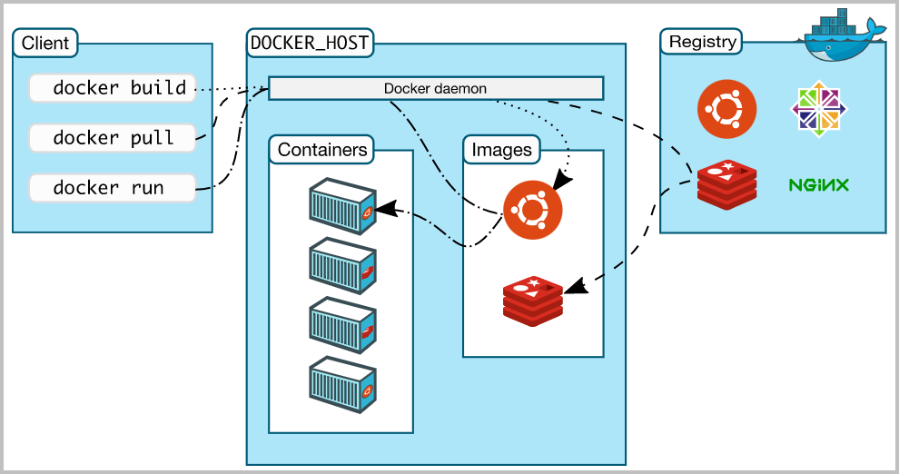
Docker Components

Slide 5
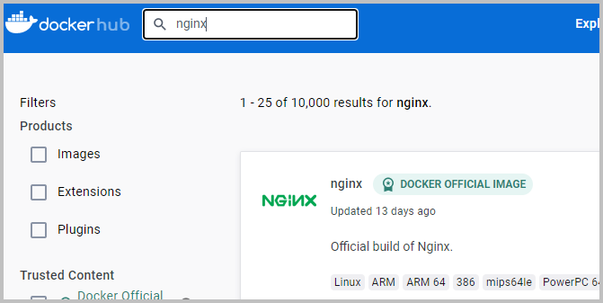
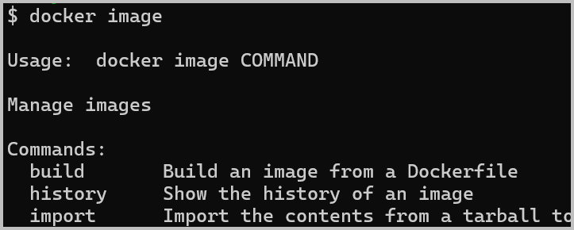
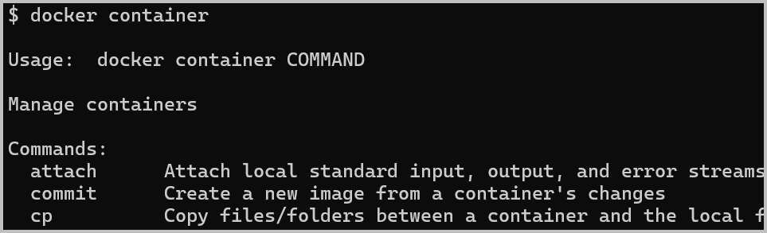
Docker Components
Docker Client – Where the user/admin issues Docker commands
Docker Daemon – Implements the Docker API
Docker Host – Where the Docker daemon runs and where all containers run and images reside
Registries – Locations of images that will be used by the system
Docker Hub
ECR
GCR
Etc.
Images – Read-only templates on which containers are based. Images can be built, pushed to/pulled from a registry, deleted
Containers – A runnable instance of an image. Can be started, stopped, moved, deleted, attached to, etc.

Slide 6
Install Docker

Slide 7



Installing Docker on WSL
Clone this repo to your WSL instance
Run the installation script
Issue | Workaround
Ubuntu usually uses systemd to manage system processes, but this isn’t available on WSL. Docker wants to start with systemctl start docker, but this isn’t available. | After each WSL reboot:
Ubuntu 22.04 uses the newer “iptables-nft”, but this isn’t supported in WSL. Docker fails to start, even with the previous workaround | Update the system configuration to use the legacy IPTables. “update-alternatives --config iptables” and select legacy. This should already be done with the install-docker.sh script.

Slide 8



Docker Group
Members of the “docker” group can run Docker commands without using “sudo”.
The installation script should have added your username to the docker group.
In order for that change to take effect, you’ll need to quit your WSL window and come right back into it
Now confirm that your user picked up the group change

Slide 9
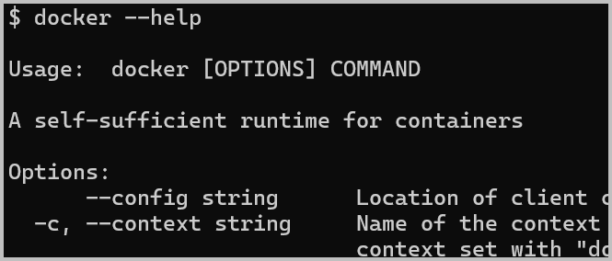
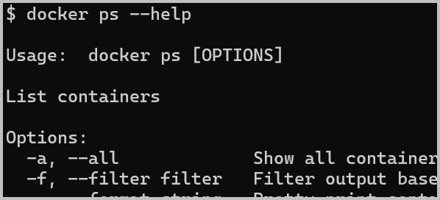
Docker Help
Help is available with the --help command line option
And help on sub-commands is also available

Slide 10
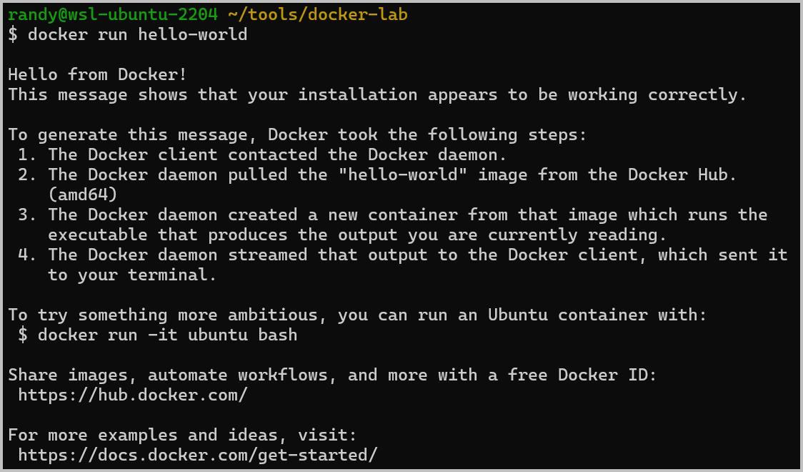
Docker Hello-World
Let’s test the Docker installation by running “hello-world”
This will download (if needed) and run the hello-world container.
It doesn’t really do anything – just prints this screen and exits. But it confirms that Docker is working correctly.
NOTE: If it doesn’t work, check out some of the troubleshooting steps in Getting Started with WSL. Specifically:
Install and Confirm Settings
Fixing WSL2 Dependencies
Confirm WSL2 Instance

Slide 11
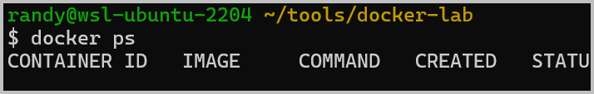
Running Containers
Let’s see what containers are currently running
Let’s try it again, with the –a switch to “show all”
Note that our hello-world is still listed, but that it stopped a while ago
AUDIT ALERT: “docker ps” is a quick check for any long-lived containers. The container has not been updated since it was last started.

Slide 12
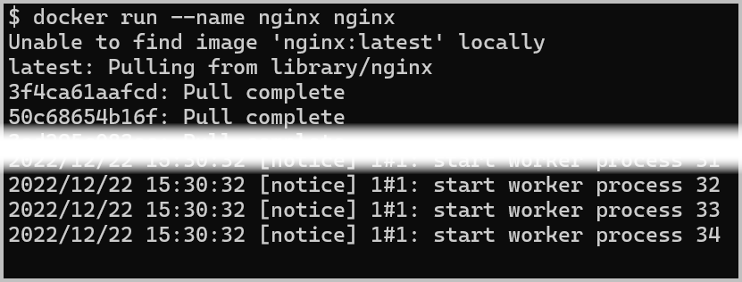
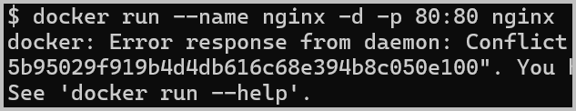


How about a web server?
Let’s start an nginx web server
What’s happening? It appears to be hung?
nginx is running (we could confirm this w/ docker ps in another window)
We just forgot some options
Press CTRL-C to quit
Run it again with these additional options
Now it tells us that we have a name conflict
We have to remove our no-longer-running container that’s using the “nginx” name (or give the new container another name)
Ahhh… success!

Slide 13
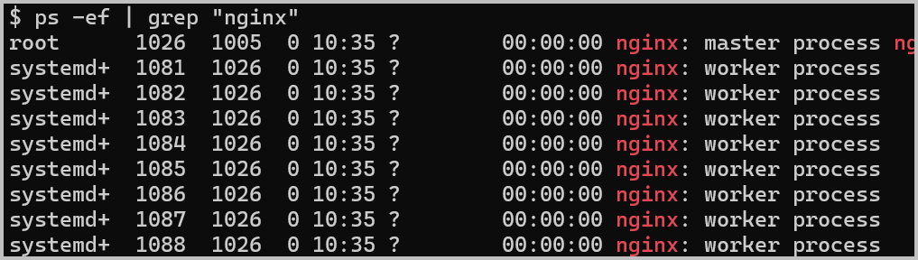
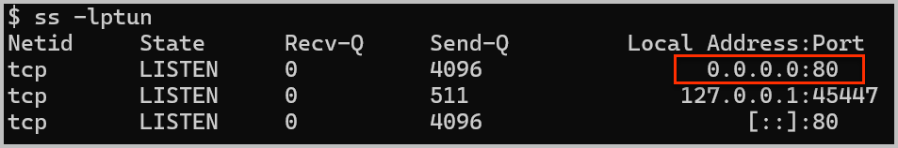
Let’s take a look at the Docker Host
Let’s look at the running processes
These are the processes as observed by the host
Take note of the user ID (column 1) – we’ll come back to that later
Let’s look at the listening ports
Note there’s a service listening on TCP/80

Slide 14
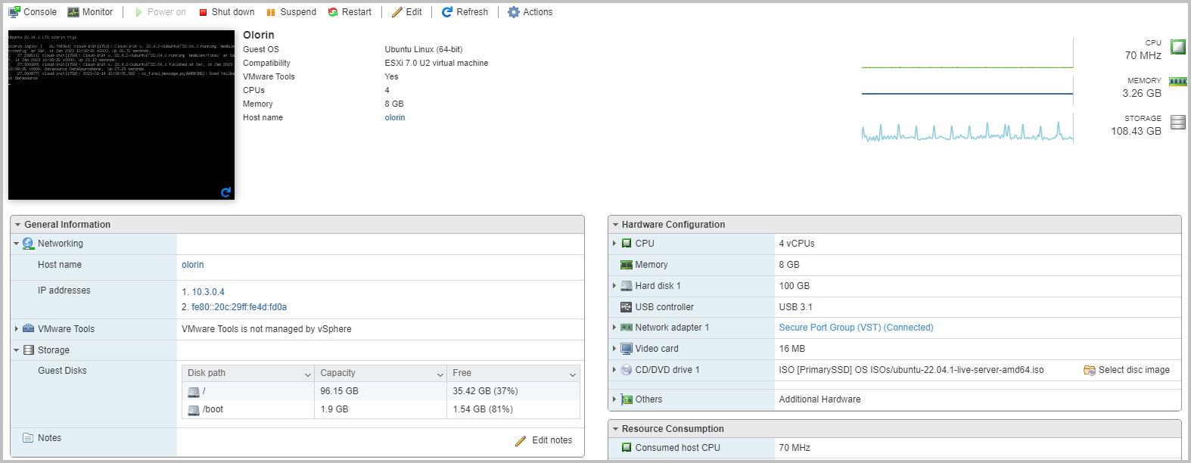
Containers vs Virtual Machines
We just looked at kernel compute and network resources being used by containers
This is one important way that containers and hypervisors are different!
Containers abstract OS kernel compute, storage, and network resources.
Hypervisors abstract physical compute, storage, and network resources

Slide 15
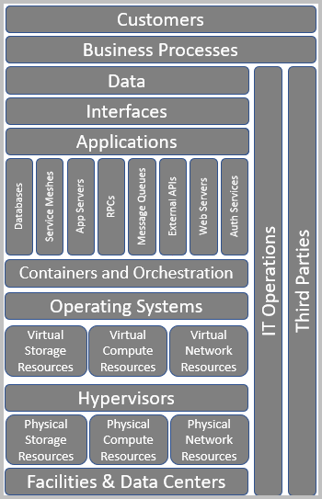
Containers vs Virtual Machines
Containers (usually) run directly on an OS, which itself could be a virtual machine, but this is changing…
VMWare can run Kubernetes workloads natively
Proxmox can run LXC containers natively
Hypervisors – at least Type I hypervisors – run directly on bare metal servers and integrate with storage and network infrastructure

Slide 16
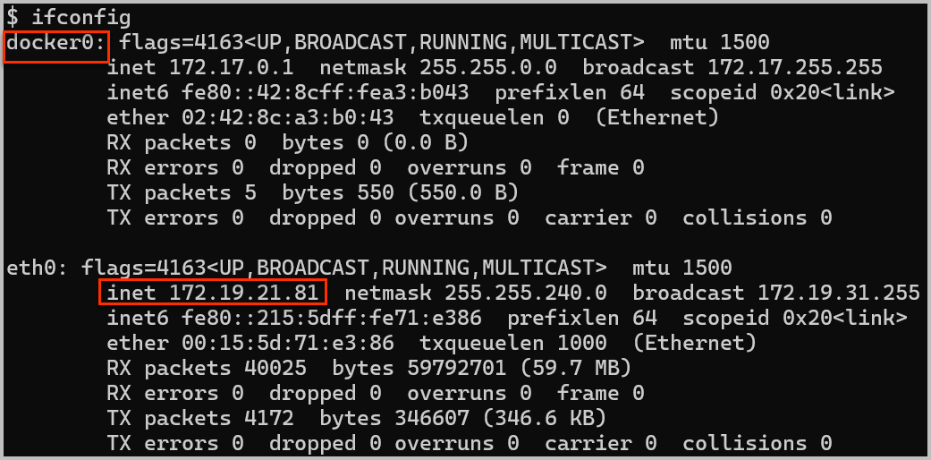
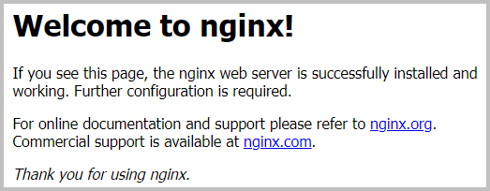

A web server is a web server…
Get your WSL instance’s IP address
You probably want the one listed as “eth0” but while we’re here, take note of the one labeled “docker0”. We’ll come back to that later.
Now point your web browser at that IP address on port 80

Slide 17

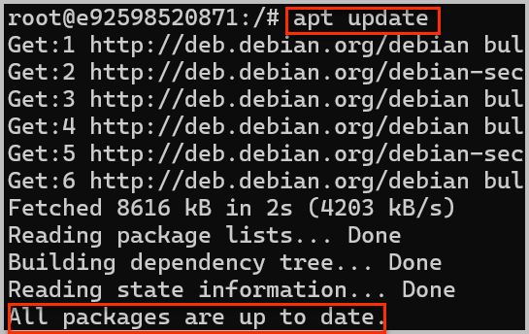
Down the rabbit hole…
Now we’re going to connect to that running container
Note the prompt changed – we’re in Wonderland now!
What distro did they build nginx on?
Looks like Debian 11, and Ubuntu is derived from Debian, so many of the commands should be the same (if they’re installed)
Is it current on patches?
Yep.. Looks good

Slide 18


How about the web server config?
Nginx configs are kept in /etc/nginx, so change your directory to there
Less is a good tool to peruse config files
Whoops… not installed. This is a minimal Debian installation
We’ll need to use “cat” instead
We’re looking for the “user” line. Nginx will drop its permissions to this user. It’s at the very top of the file
This is CIS nginx benchmark item 2.2.1
But there’s a twist…

Slide 19
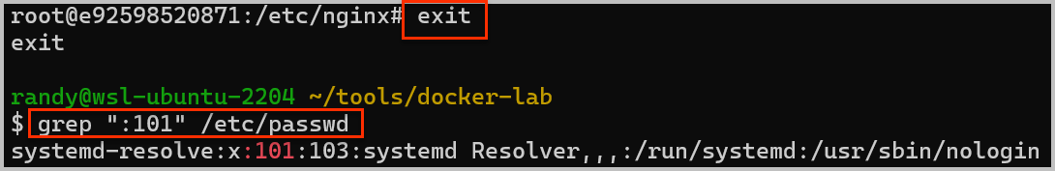
How about the web server config?
Now let’s review the /etc/passwd file to get the uid for nginx
ID 101 and while you’re there, note that the user’s shell is set to /bin/false – meaning the user can’t be used for interactive logins.
Let’s climb out of the rabbit hole for a minute… back on the Docker host
It’s the systemd-resolve account. It’s not “root”, but the systemd-resolve is the DNS resolver for Linux
This is because while processes and network resources each get their own “namespace”, by default users are shared between the container and the host
There’s a feature call “user namespace remapping” that can be enabled, but it could also break stuff, so it’s not used on many customer-run Docker stacks

Slide 20

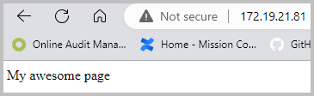
Data Persistence
Back into the container…
The web server content is currently at /usr/share/nginx/html
Let’s replace the index.html with our own
And refresh the browser
But this content won’t survive after this container is replaced with a new version

Slide 21
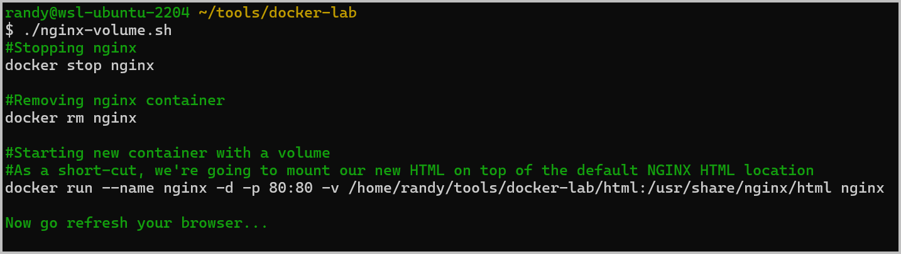
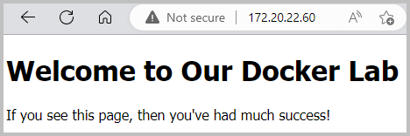
Data Persistence
Let’s set up a volume using storage from the Docker host – the docker-lab/nginx-volume.sh script performs these actions
Stop and remove the container
Run it again, this time with a –v The web server content is currently at /usr/share/nginx/html
Let’s replace the index.html with our own
And refresh the browser
Now the web server content will survive a rebuild/replace of the container

Slide 22


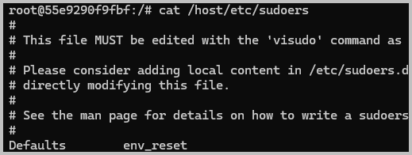
A Simple Container Escape
By default the user namespace is shared between container and host
Try to display the host’s /etc/sudoers file
Let’s start an Ubuntu instance that mounts our host’s file system (note the # prompt)
And now try to display the host’s /etc/sudoers file (it will be at /host/etc/sudoers)
SUCCESS – our container is running as ROOT on the host and gets all of ROOT’s permissions
We could… edit the /etc/sudoers to give ourselves sudo permissions (that is, root permissions) on the host

Slide 23
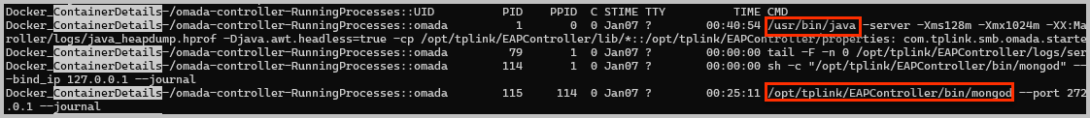
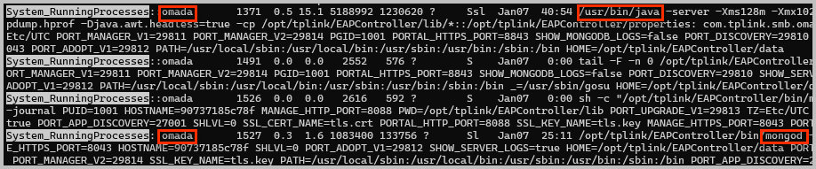
Container-Host Permissions Redux
There are lots of ways that containers and/or apps can drop their permissions
Docker “rootless” mode -- https://docs.docker.com/engine/security/rootless/ (new since Docker 20.10)
The Dockerbuild file’s USER directive
Docker user namespace remapping (user-ns in the Docker config file or on the command line visible in the process List)
Docker command line options such as --user and --PUID / --PGID
Nginx has a “user” setting in the config file
I’m sure there are more…
The most certain way to tell what user the container processes are running as is to compare the container’s process list (Docker_ContainerDetails…RunningProcesses) to the host’s process list (System_RunningProcesses in the kpnixaudit results)

Slide 24
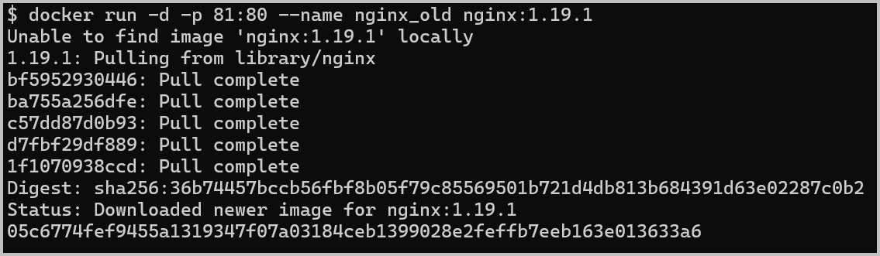
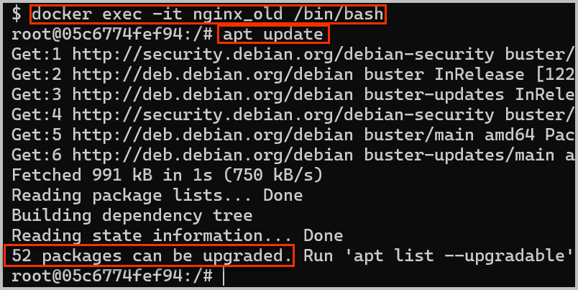
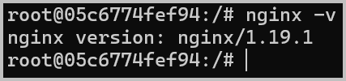
Back to patches for a minute
Let’s start up an intentionally old version of nginx
Notice the –p 81:80
Notice the version identifier after the image name
You’ll now have a second web server on port 81
But what does it look like inside the container?
Apt update? Nginx version?
https://nginx.org/en/security_advisories.html
AUDIT ALERT: It’s standard practice to hard code the version (usually as a SHA2 hash) into the CI build

Slide 25
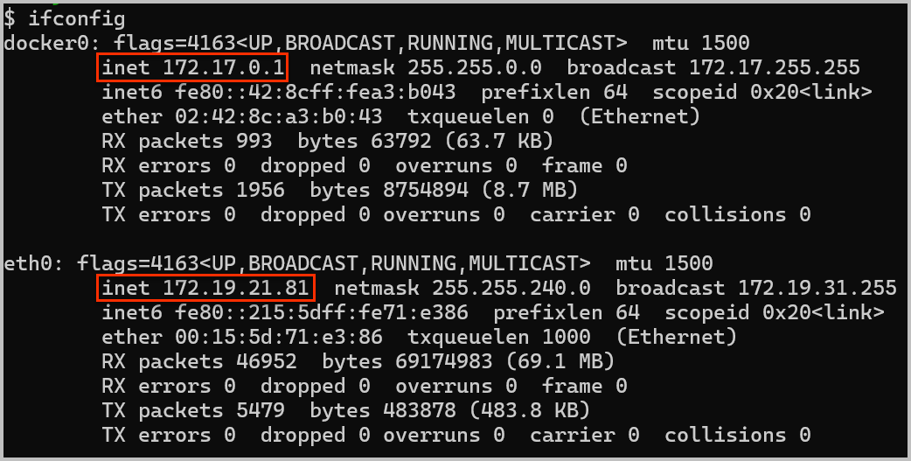
Docker Networking
Remember that docker0 interface a while back?
It’s on a private network local to just the Docker Host
Try pinging that address from your WSL instance
Now from the nginx container
Try it from PowerShell on the same box
This is a private address only reachable from the Docker Host and local containers

Slide 26
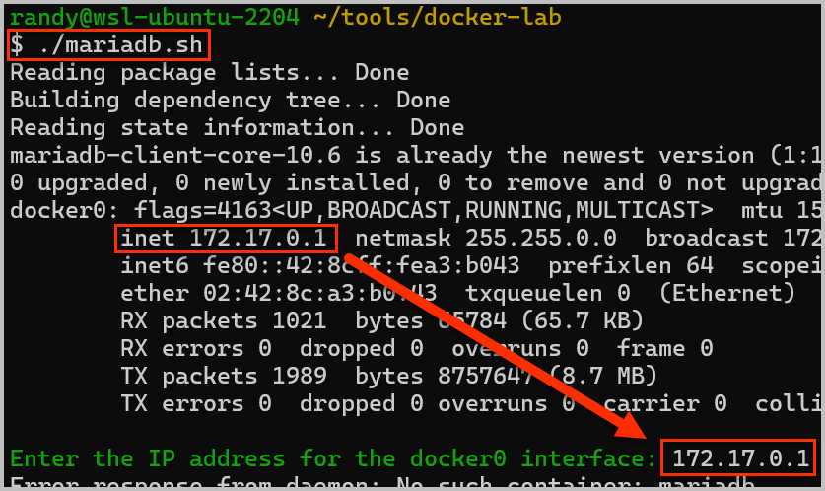
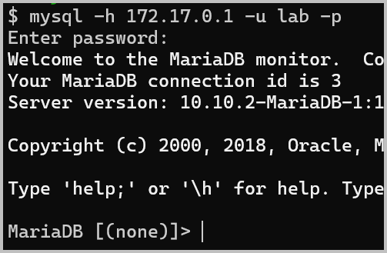
Docker Networking – Practical Example
Let’s set up a MariaDB database server on that network so that only our web server can get to it
Now try to connect to it with the mysql command line client
AUDIT ALERT: This is an example of “isolation or segmentation” and should be part of the PCI pen test for 11.3.4

Slide 27
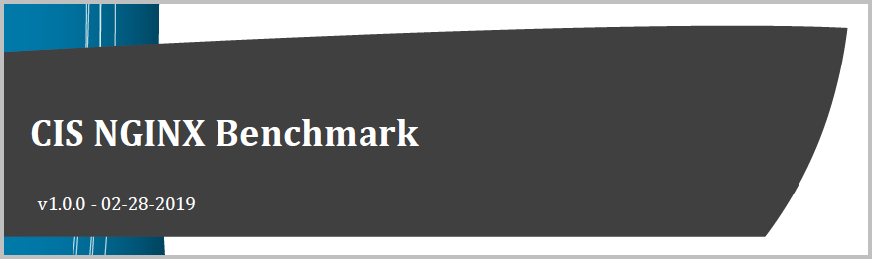
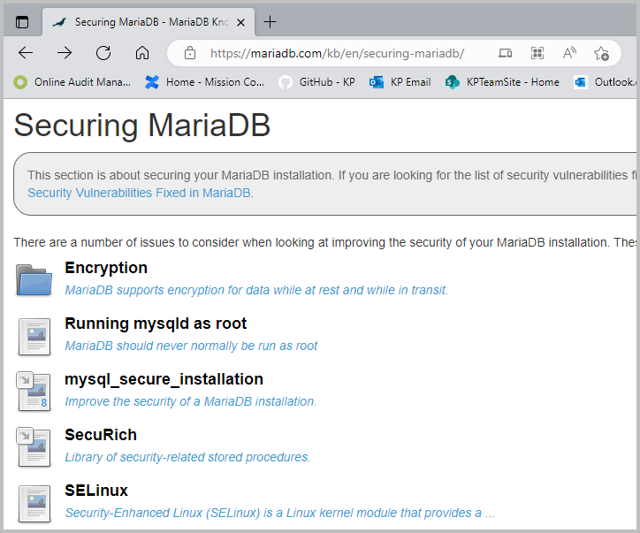
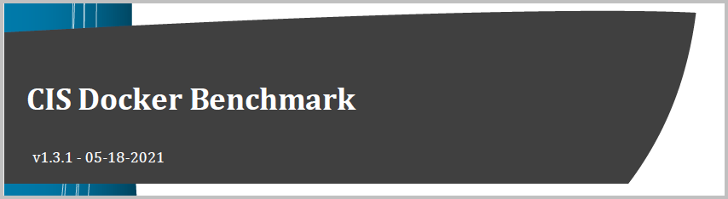
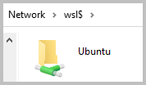
Something a bit different
So far we’ve seen that Nginx is … well.. Nginx. And MariaDB is MariaDB.
They need to be hardened and patched and network-isolated and logged and … and … and … just like their non-containerized cousins
But there’s also good security for the Docker Host, and it’s the same stuff we’ve been doing for a long time
Harden and patch the OS
Harden and patch the Docker runtimes
Harden and patch the containers
Let’s crack open the Docker Benchmark
They’re in the Docker-lab cloned directory
In File Explorer – enter \\wsl$ and start browsing your WSL file system

Slide 28
Summary
Containers are just mini-versions of Linux operating systems that run (usually) just one application at a time
Process isolation is enabled out of the box, but the user namespace is shared with the runtime host
You can connect to – and interact live with – most containers with docker exec -it <container> /bin/bash
If that doesn’t work, try /bin/sh instead
Software inside containers is nearly identical to the same software run natively.
Needs to be patched
Needs to be hardened
Complex networks can be built up – and traffic never leaves the runtime host – a form of network isolation/segmentation
Securing Docker is like securing anything else – patch it, harden it, log it, control access to it, and so one

Slide 29

Q&A

